Slide 1
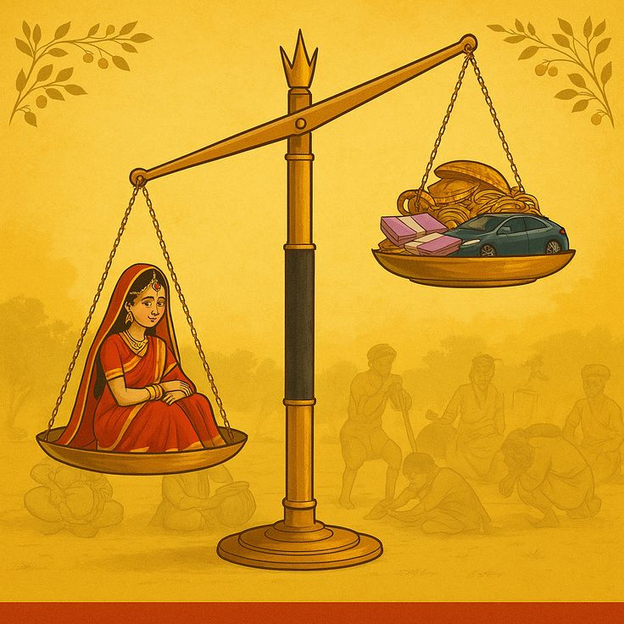
Dowry System in India
A Data-Driven Social Analysis Using Power BI
Presented by Sonam Kumari
Data Analytics Project

Slide 2
Problem Statement & Real Issues
Dowry remains a persistent social issue in India.
Dowry-related violence affects women's safety and dignity.
Conviction rates remain lower than reported cases.
Data-driven monitoring is essential for awareness and reform.

Slide 3
Project Objectives
Analyze dowry death trends (2019–2023).
Identify high-risk states.
Study conviction rate patterns.
Build an interactive and insight-driven dashboard.

Slide 4
Dataset & Methodology
Structured CSV dataset (State, Year, Crime Metrics).
Data cleaning using Power Query.
DAX measures for KPIs and growth analysis.
Interactive visual design with slicers.

Slide 5
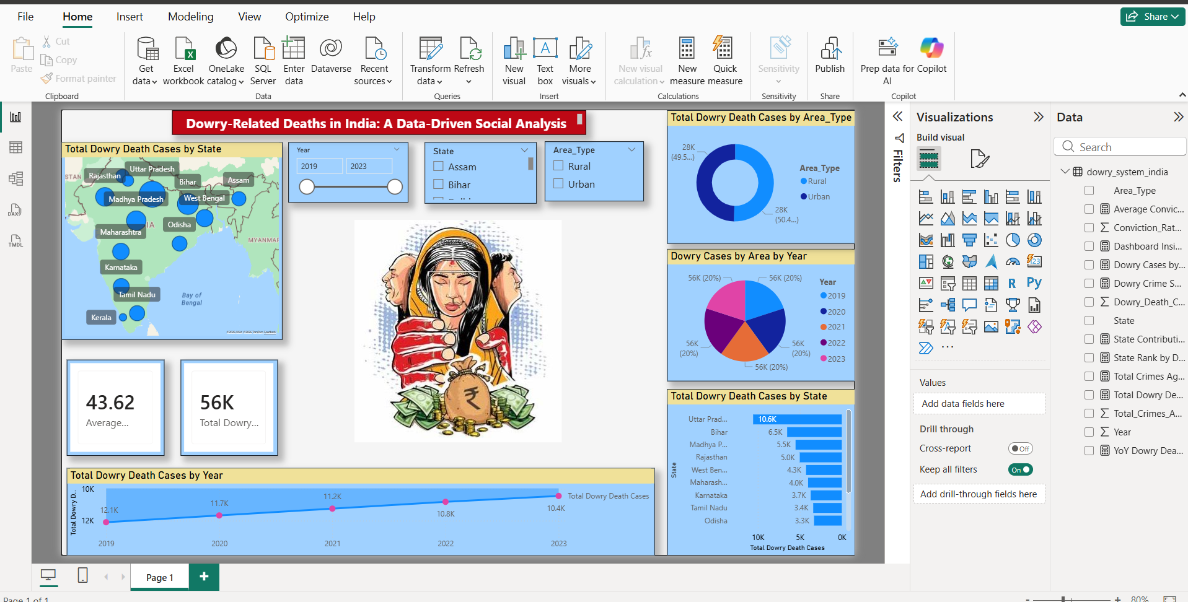
Interactive Dashboard Overview

Slide 6
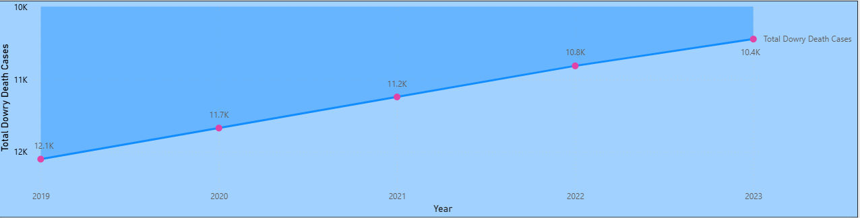
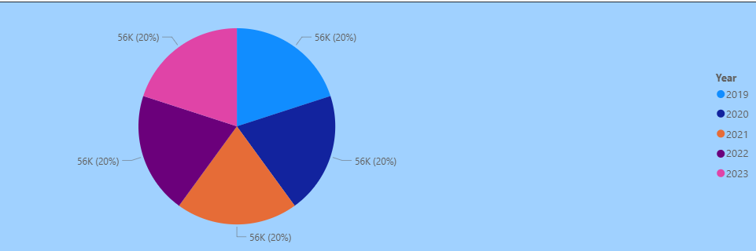
Key Visual Insights

Slide 7
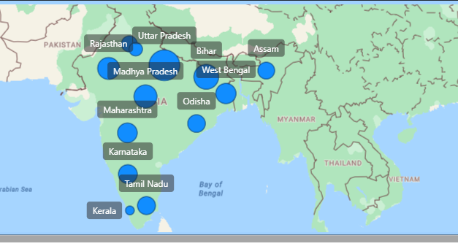

Slide 8
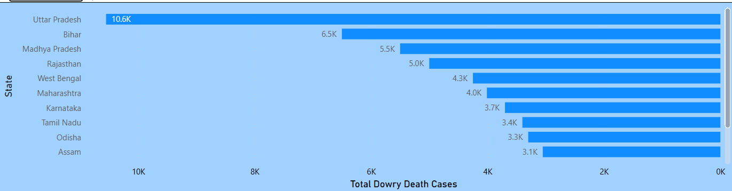
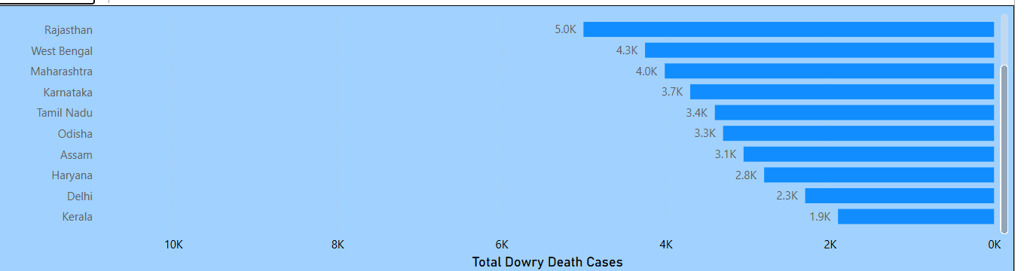

Slide 9
Key Insights from Analysis
Certain states consistently report higher dowry deaths.
Urban vs Rural patterns reveal social disparity.
Trend shows fluctuation rather than elimination.
Conviction improvement still required.

Slide 10
Conclusion & Social Impact
Data visualization transforms statistics into awareness.
Interactive dashboards support policy-level understanding.
Continuous monitoring is necessary for long-term change.

Slide 11
Thank You
Questions & Discussion
Thank you for your attention.

